Slide 1
Book - Recommendation System
BiS Capstome
Sydney Jue
Sydney Jue
Book Genre
Year Published
Data Science
2025

Slide 2
Problem
Statement
Hypothesis Formation: Can the Online Book app increase their sales of books through their store per customer based on a recommendation system.
Context:
An online book app wants to suggest new books to customers/users to keep up engagement and to sell more books through their store. On average an ebook
Criteria for success: Users purchase more books from the app’s store based on their recommendation section
Student Name
Class Name

Slide 3
The Dataset
Kaggle
This Dataset was found on Kaggle and was originally 3 separate datasets, Users, Books and Ratings.
Cleaning
Dropping unnecessary columns (image columns and age)
Merge dataframes together
Look for missing data
Separate into explicit and implicit dataframe
Take a 100k sample of the dataset
Save sampled explicit data
Student Name
Class Name

Slide 4
Exploratory Data
Analysis
Student Name
Class Name

Slide 5
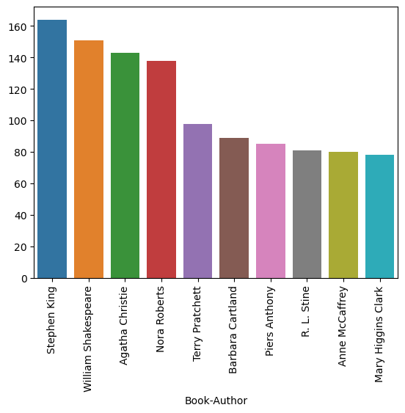
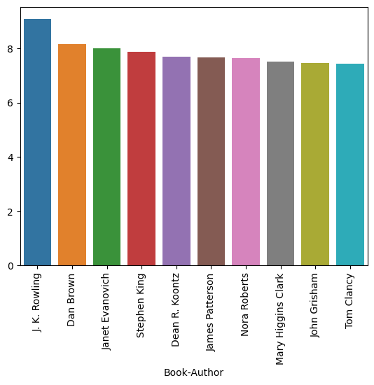
Which Authors had written the most books?
Which Authors are considered the most popular based on ratings?
As we can see J.K Rowling had the highest mean ratings with a 9.07. Dan brown had a mean rating of 8.16, Janet Evanovich had a rating of 8.01 and the rest were somewhere in the 7.8 to 7.4 range.
Using a groupby and nunique and sorting values from highest to lowest, the authors with the most written books was revealed. From our given dataset, Stephen King wrote 164 books, William Shakespeare wrote 151 books, and Agatha Christie wrote 143 books.
Student Name
Class Name
Notes:
To find the authors with the highest ratings ratings, the dataset was grouped by author and the book_ratings were summed, the values were sorted from highest to lowest sum. After that we take the names that were in the top ten and find them within the dataset and save it to pop_author_names. Finally the we group pop_author_names by the author and aggregate the book rating mean.

Slide 6
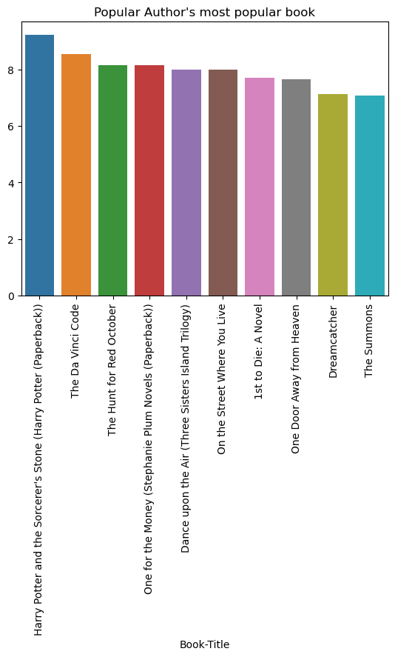
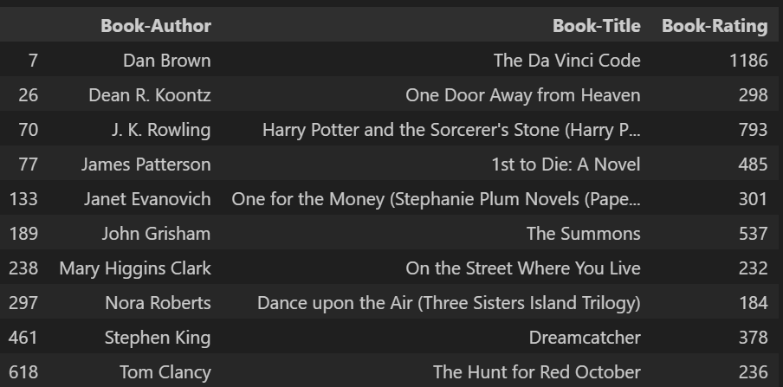
Based on the highest Rated authors, Which book is their most popular?
Finding the most popular author’s most popular book was relatively easy, as all we needed was the pop_author_names. From that dataset, the data was grouped by the author and book title and we got the aggregate sum value of book_rating. We sort two values, one descending and one ascending, Book-author and book rating respectively.
Student Name
Class Name

Slide 7
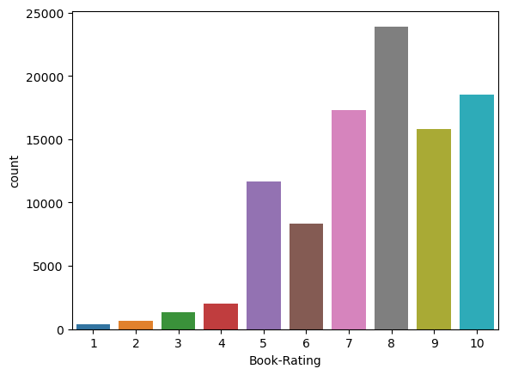
Most common Ratings for books?
All that is needed to get the common ratings for books is getting the distribution of the Book_ratings column. Most ratings were 7 and above.
Student Name
Class Name

Slide 8
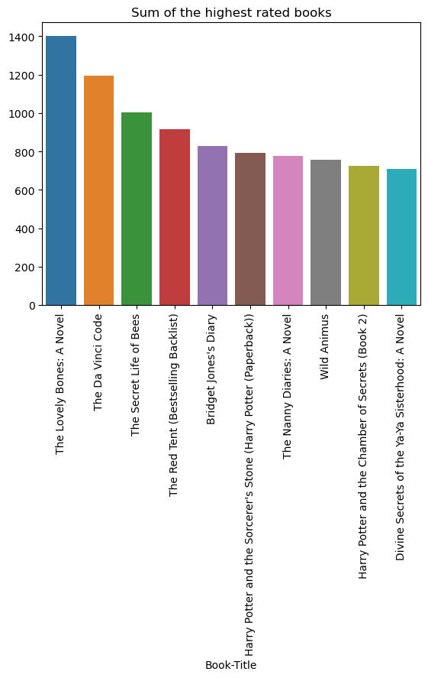
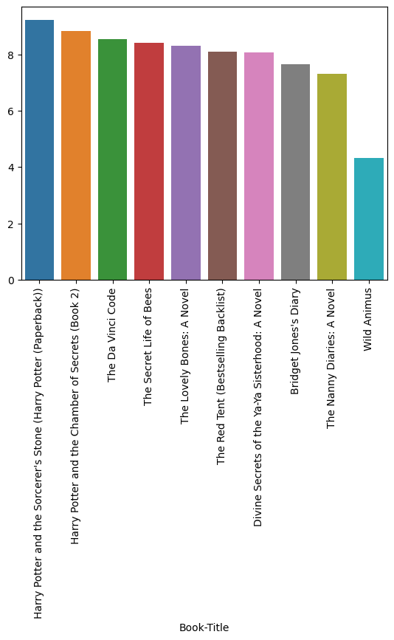
Which books are considered popular by Rating
While lovely bones had the highest sum ratings, the actual mean ratings show that both Harry Potter books, The Davinci Code and The Secret Life of Bees had higher mean ratings, with ratings of 9.2, 8.8, 8.5, and 8.4.
From the original dataframe, we group the data by book title and we get the sum of the book_ratings.
Student Name
Class Name
Notes:
To find the authors with the highest ratings ratings, the dataset was grouped by author and the book_ratings were summed, the values were sorted from highest to lowest sum. After that we take the names that were in the top ten and find them within the dataset and save it to pop_author_names. Finally the we group pop_author_names by the author and aggregate the book rating mean.

Slide 9
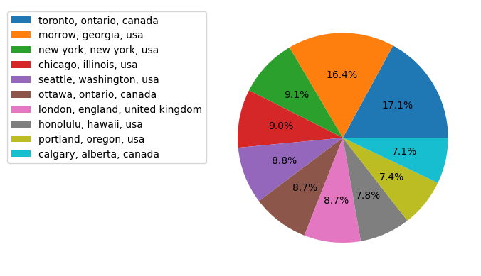
Location where most users are from?
Most readers are from the USA, with a 58.5% the most readers in the USA being from Morrow, Georgia. Canada had 32.9% with Toronto having the most readers.
Student Name
Class Name

Slide 10
Preprocessing and Modelling
Student Name
Class Name

Slide 11
SVD
Train/test split
Create a scikit-surprise reader to create a surprise object. The only columns in the surprise object is user_ID, ISBN and Book-rating. The data is then split using a 80/20 split.
SVD vs ALS
Choose between SVD or ALS in scikit surprise.
RMSE in ALS = 1.706, MAE = 1.339
RMSE in SVD = 1.694, MAE = 1.32. SVD is the better choice
Choosing best parameters
Using a RandomizedGridSearch the best params are lr_all = .002, n_factors = 50, reg_all = 0.03 and n_epochs = 50. RMSE = 1.35 and MAE =1.04
Student Name
Class Name

Slide 12
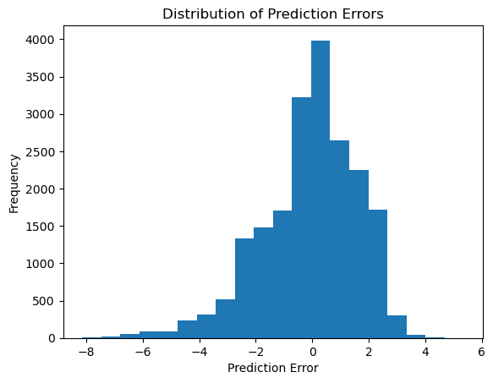
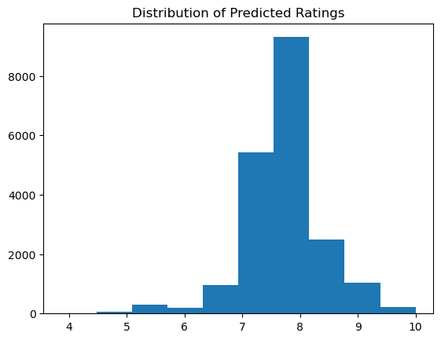
The X range from -8 to 6 means that there are some cases where the predictions were significantly off either overestimating or underestimating, however given that there’s a bell centered around 0 suggests that most predicted errors are small which means the model generally accurate.
It appears that most predictions have a score of 7 and 8, which based on what we’ve seen for common book ratings makes sense.
Student Name
Class Name
Notes:
To find the authors with the highest ratings ratings, the dataset was grouped by author and the book_ratings were summed, the values were sorted from highest to lowest sum. After that we take the names that were in the top ten and find them within the dataset and save it to pop_author_names. Finally the we group pop_author_names by the author and aggregate the book rating mean.

Slide 13
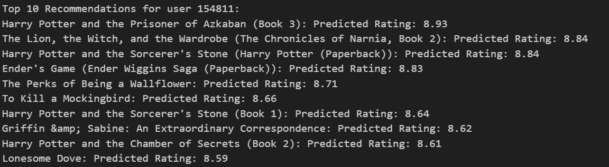
Recommendations
Example:
Geting all the unique ISBN, then the predicted rating for each user is calculated, giving estimated ratings for each ISBN by the specified user. Then the predictions are sorted in descending order giving us the highest predicted rating first.
Student Name
Class Name

Slide 14
Thank You
Class Name
Student Name

